Slide 1

Home Loan Credibility Assessment
Bhaskar Das
Springboard Data Science Career Track, May 2019 cohort
Capstone Project 1: Final Report (GitHub Project Link)

Slide 2
Table of Contents
Problem Statement
Business Problem
Business Objective
Data Collection
Exploratory Data Analysis
Machine Learning
Data Preparation
Model Evaluation
Feature Importance
Conclusion

Slide 3
Problem Statement
Business Problem:
Banks and financial institutions check traditional credit score models, which include demographic characteristics, historical payment data, credit bureau data and application data, to determine repayment success.
Many unbanked individuals do not have sufficient credit scores due to their past mistakes of unavoidable circumstances.
It is important to identify these individuals from financial records to provide a positive and safe borrowing experience.
Business Objective:
Build a model to predict the likelihood that an applicant will repay their loan.

Slide 4
Data Collection
Data source: https://www.kaggle.com/c/home-credit-default-risk/data.
The data is acquired from seven different sources.
The first dataset, application_train and application_test, is the main training and testing data with information about each loan application.
Each row is identified by the feature SK_ID_CURR.
The TARGET feature
0 → represents load repaid
1 → loan not repaid

Slide 5
Data Collection [contd.]
The other six data sources are described below:
Bureau: provides the client's previous credits from other financial institutions.
Bureau_balance: provides monthly balances of previous credits in the Credit Bureau.
POS_CASH_balance: presents monthly balance snapshots of the previous point of sales and cash loans that the applicant had with Home Credit.
Credit_card_balance: the monthly balance snapshots of previous credit cards that the applicant has with Home Credit.
Previous_application: all previous applications for Home Credit loans
Installments_payment: repayment history for the previous loans

Slide 6
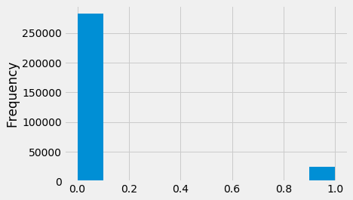
Exploratory Data Analysis (EDA)
EDA finds trends, anomalies, patterns, or relationships within the data.
Examine the Distribution of the Target Column:
Imbalanced class problem
More entries on loan repaid on time
Less entries on loans not repaid

Slide 7
Exploratory Data Analysis (EDA) [contd.]
Missing value treatment:
Missing data can lead to a wrong prediction.
There are 122 columns in the training data and 67 of them contain missing values.
More than 50% of missing values in most of the columns.
Deleting the missing values is not a good option.
Use imputation to fill in the missing values.
Encoding Categorical Variables:
Most of the machine learning models cannot deal with categorical variables.
Encode the categorical variables as numbers.
Label Encoding is used for those categorical variables which have only two categories.
Does not create new columns
The rest of the categorical variables are encoded using One-Hot Encoding.
Creates a new column for each unique category

Slide 8
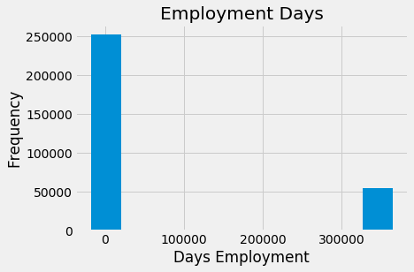
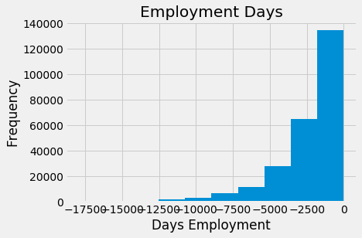
Exploratory Data Analysis (EDA) [contd.]
Outlier:
The days of employment column contains outliers.
Maximum employment days can not be 1000 years.
All the outliers have the exact same value.
We will fill in the anomalous values with not a number (np.nan)
Also create a new boolean column indicating whether or not the value was anomalous
Fig. Outlier detection
Fig. Outlier treatment

Slide 9
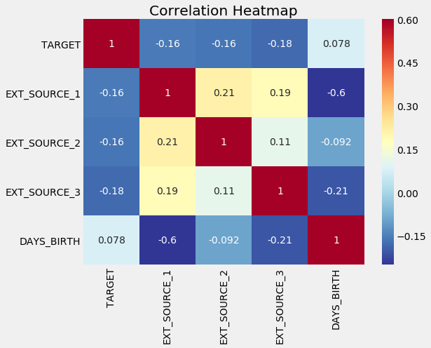
Exploratory Data Analysis (EDA) [contd.]
Correlations:
with the TARGET variable
Negative correlations: EXT_SOURCE_3, EXT_SOURCE_2, and EXT_SOURCE_1
Positive correlations: DAYS_BIRTH
The client is more likely to repay the loan when the value of the EXT_SOURCE increases.

Slide 10
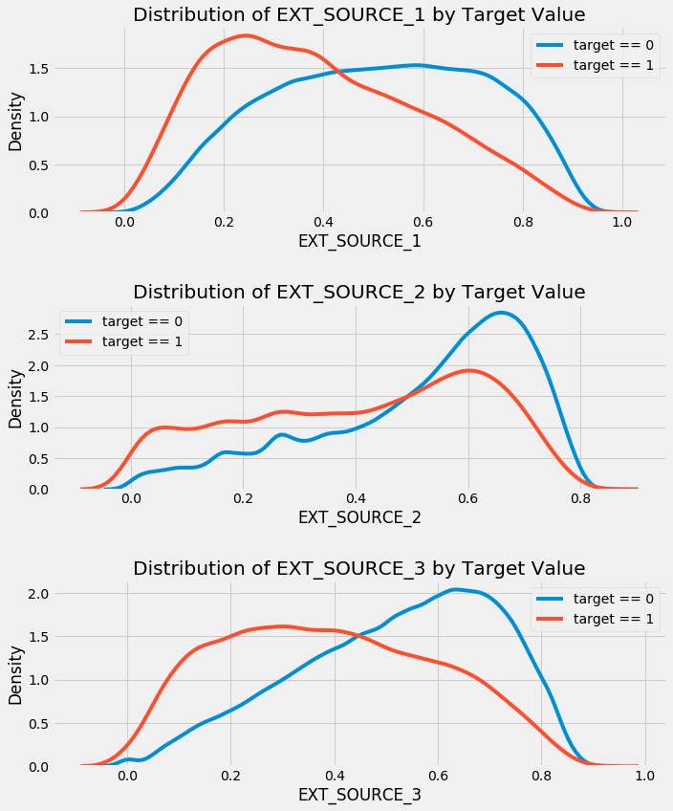
Exploratory Data Analysis (EDA) [contd.]
Correlations:
EXT_SOURCE_3 shows the greatest difference between the values of the target.
The client is more likely to repay the loan if the value of the EXT_SOURCE_3 variable is higher.

Slide 11
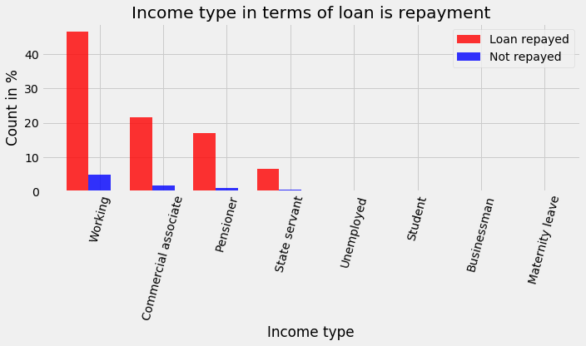
Exploratory Data Analysis (EDA) [contd.]
Observe the income type of the client's in terms of the loan is repaid or not:
The client's with income type "working" tends to repay loans.

Slide 12
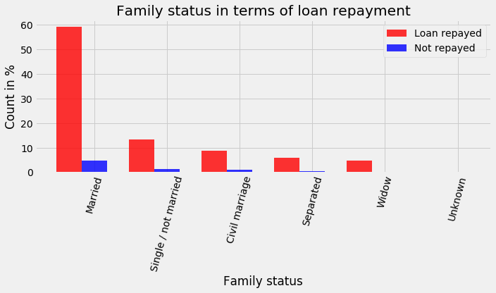
Exploratory Data Analysis (EDA) [contd.]
Family status in terms of the loan is repaid or not:
The client with family status as "Married" tends to repay loans.

Slide 13
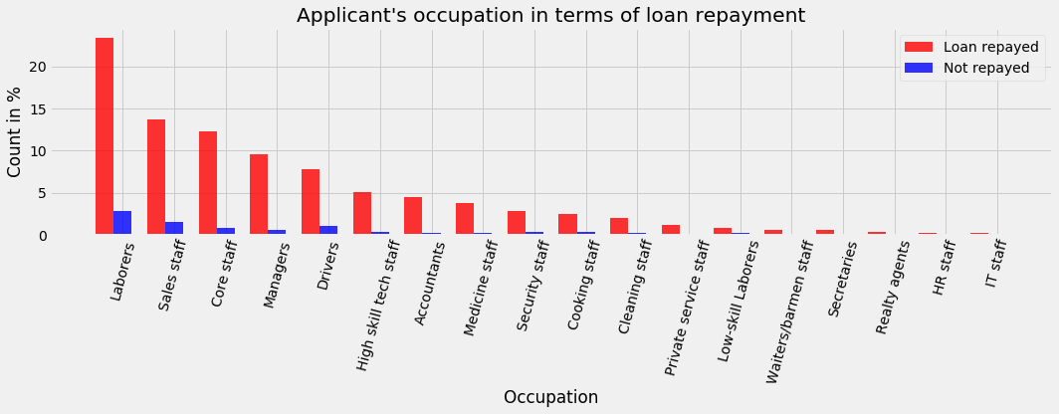
Exploratory Data Analysis (EDA) [contd.]
Occupation of the applicant's in terms of the loan is repaid or not:
Clients with occupation "Laborers" are better at loan repayment followed by "Sales staff", "core staff", "Managers", and "Drivers".
The difference in percentage is not significant.

Slide 14
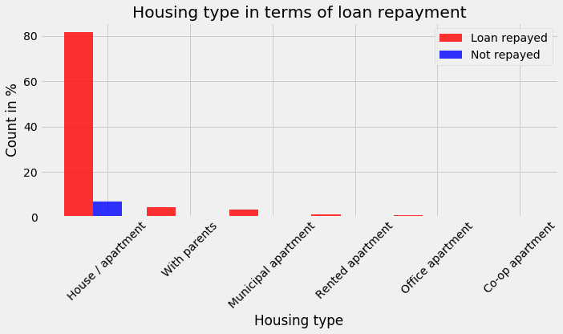
Exploratory Data Analysis (EDA) [contd.]
Applicant's Housing type in terms of the loan is repaid or not:
The applicants who live in the "House/apartment" are more likely to repay the loan.

Slide 15
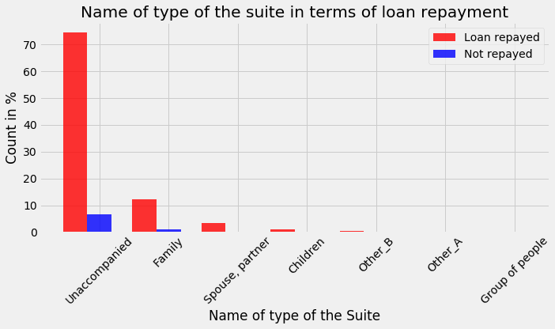
Exploratory Data Analysis (EDA) [contd.]
Name of the type of the suite of the applicants in terms of the loan is repaid or not:
The applicants who are "Unaccompanied" are more likely to repay the loan.

Slide 16
Machine Learning
Data Preparation:
Imbalanced class problem
More than 50% missing values
To find out the best machine learning model for our project, we have explored three different data preparation approach
Method 1: Prepared the data by deleting rows with the mission values and under-sampling the loan repaid data.
Method 2: Prepared the data by deleting rows with mission values, under-sampling the loan repaid data, and dropping columns using multicollinearity analysis.
Method 3: Prepared the data by using the imputation to handle the mission values.
Split data into two parts: 70% for training and 30% for testing.

Slide 17
Machine Learning [contd.]
Model Evaluation:
Evaluation of the data preparation methods with the confusion matrix and the ROC-AUC score
Method 1:
Confusion_matrix:
[[314 126]
[ 66 94]]
Classification report:
Precision | recall | f1-score | support
0 0.83 | 0.71 | 0.77 | 440
1 0.43 | 0.59 | 0.49 | 160
ROC-AUC score of the model: 0.7112357954545454

Slide 18
Machine Learning [contd.]
Model Evaluation:
Evaluation of the data preparation methods with the confusion matrix and the ROC-AUC score
Method 2:
Confusion_matrix:
[[312 128]
[ 67 93]]
Classification report:
Precision | recall | f1-score | support
0 0.82 | 0.71 | 0.76 | 440
1 0.42 | 0.58 | 0.49 | 160
ROC-AUC score of the model: 0.7150710227272726

Slide 19
Machine Learning [contd.]
Model Evaluation:
Evaluation of the data preparation methods with the confusion matrix and the ROC-AUC score
Method 3:
Confusion_matrix:
[[70550 14291]
[ 3664 3749]]
Classification report:
Precision | recall | f1-score | support
0 0.95 | 0.83 | 0.89 | 84841
1 0.21 | 0.51 | 0.29 | 7413
ROC-AUC score of the model: 0.7532392541750991

Slide 20
Machine Learning [contd.]
Model Evaluation:
Method 3 gives the best accuracy: 75.32%
Model Comparison:
Light Gradient Boosting most accurate
75.72%
Model | ROC-AUC score
Light Gradient Boosting | 0.7572148211583262
Gradient Boosting | 0.7541132339818492
Ridge Regression | 0.746597202421708
Linear Regression | 0.7465839697165486
Adaptive Boost Regressor | 0.7114294585068995
Decision Tree Regression | 0.7114294585068995
Random Forest | 0.6387905135104288
Lasso Regression | 0.6315649732588609
Logistic Regression | 0.627274997423726

Slide 21
Machine Learning [contd.]
Feature Importance:
New features:
'DAYS_EMPLOYED_PERC': derived by dividing 'DAYS_EMPLOYED' by 'DAYS_BIRTH'.
'INCOME_CREDIT_PERC': derived by dividing 'AMT_INCOME_TOTAL' by 'AMT_CREDIT'.
'INCOME_PER_PERSON': derived by dividing 'AMT_INCOME_TOTAL' by 'CNT_FAM_MEMBERS'.
'ANNUITY_INCOME_PERC': derived by dividing 'AMT_ANNUITY' by 'AMT_INCOME_TOTAL'.
'PAYMENT_RATE': derived by dividing 'AMT_ANNUITY' by 'AMT_CREDIT'

Slide 22
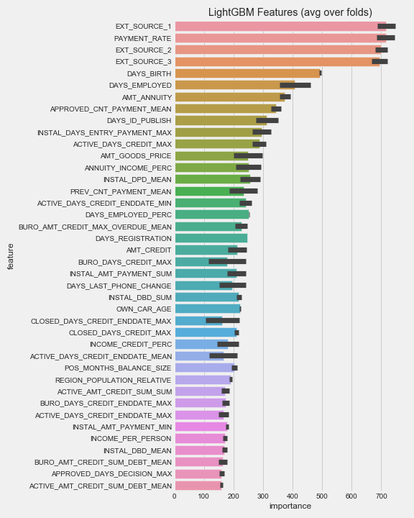
Machine Learning [contd.]
Feature Importance:
Best Features | ROC_AUC Score
10 | 0.749384
25 | 0.756939
50 | 0.757502
60 | 0.757414
70 | 0.757372
80 | 0.757528
90 | 0.757972
100 | 0.757626
150 | 0.757246
200 | 0.757291
240 | 0.757362
245 | 0.757636
Top 90 features gives the best accuracy

Slide 23
Conclusion
Light Gradient Boosting machine learning model obtains the best accuracy of 75.72%
Encoded the categorical variables
Performed outlier treatment on the data
Model Evaluation:
Confusion Matrix
ROC-AUC score
Five new features added
Top 90 features gives the best accuracy: 75.80%

Slide 24
Thank You

